Slide 1
Rule-Based Classifiers
RIPPER Algorithm

Slide 2
What is RIPPER?
It stands for Repeated Incremental Pruning to Produce Error Reduction.
The Ripper Algorithm is a Rule-based classification algorithm. It derives a set of rules from the training set. It is a widely used rule induction algorithm.

Slide 3
Motivation
It works well on datasets with imbalanced class distributions. In a dataset, if we have several records out of which most of the records belong to a particular class and the remaining records belong to different classes then the dataset is said to have an imbalanced distribution of class.
It works well with noisy datasets as it uses a validation set to prevent model overfitting.

Slide 4
Before we start
RIPPER uses three algorithms in it:
Learn-One-Rule Algorithm
Sequential Covering Algorithm
FOIL’s Information Gain

Slide 5
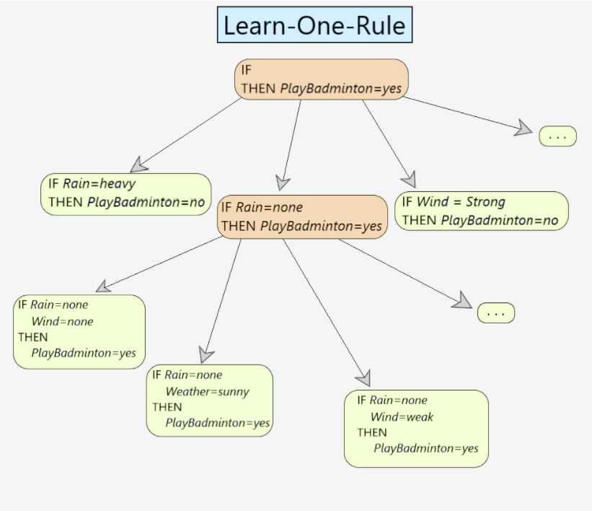
Learn-One-Rule Algorithm
The Learn-One-Rule algorithm follows a greedy searching paradigm where it searches for the rules with high accuracy but its coverage is very low. It classifies all the positive examples for a particular instance. It returns a single rule that covers some examples.

Slide 6
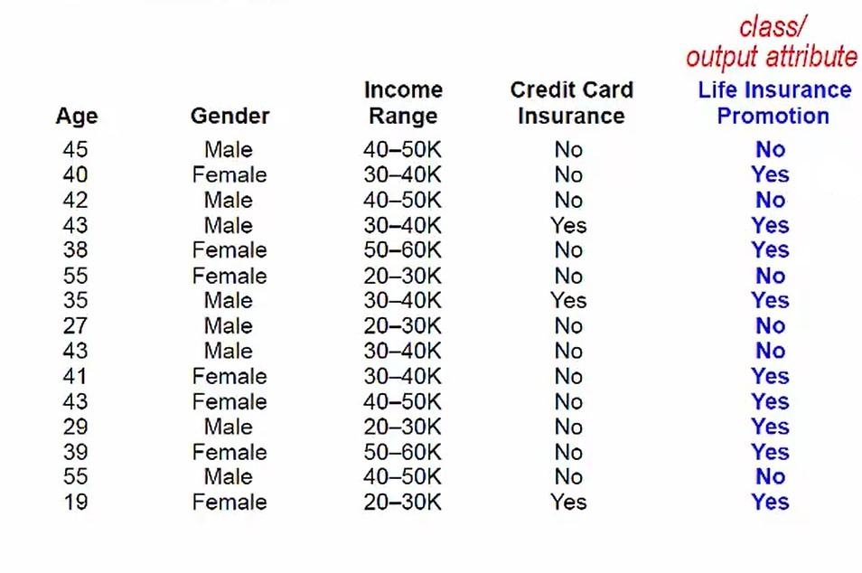
Example
Credit-Card Promotion Problem

Slide 7
Example
Let’s start by determining the rules based on Gender:
Female → YES (6 out of 7)
Male → NO (5 out of 8)
Overall accuracy = (6 + 5) / 15 = 73%

Slide 8
Example
Let’s start by determining the rules based on Credit Card Insurance:
YES → YES (3 out of 3)
NO → NO (6 out of 12)
Overall accuracy = (3 + 6) / 15 = 60%

Slide 9
Example
Let’s start by determining the rules based on Income Range:
20-30k → NO (2 out of 4)
30-40k → YES (4 out of 5)
40-50k → NO (3 out of 4)
50-60k → YES (2 out of 2)
Overall accuracy = (2 + 4 + 3+ 2)/ 15 = 73%

Slide 10
Example
Let’s start by determining the rules based on Age:
Age: <= 43 → YES (9 out of 12)
> 43 → NO (3 out of 3)
Overall accuracy = (9 + 3) / 15 = 80%
19 | 27 | 29 | 35 | 38 | 39 | 40 | 41 | 42 | 43 | 43 | 43 | 45 | 55 | 55
YES | NO | YES | YES | YES | YES | YES | YES | NO | YES | YES | NO | NO | NO | NO

Slide 11
Sequential Covering Algorithm
Sequential Covering is a popular algorithm based on Rule-Based Classification used for learning a disjunctive set of rules. The basic idea here is to learn one rule, remove the data that it covers, then repeat the same process. In this process, In this way, it covers all the rules involved with it in a sequential manner during the training phase.

Slide 12
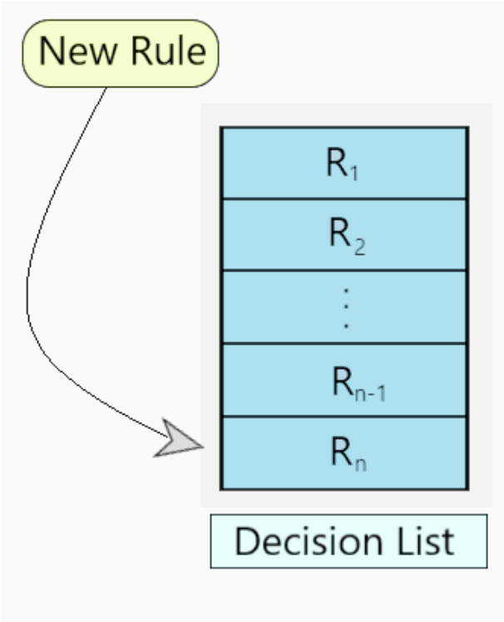
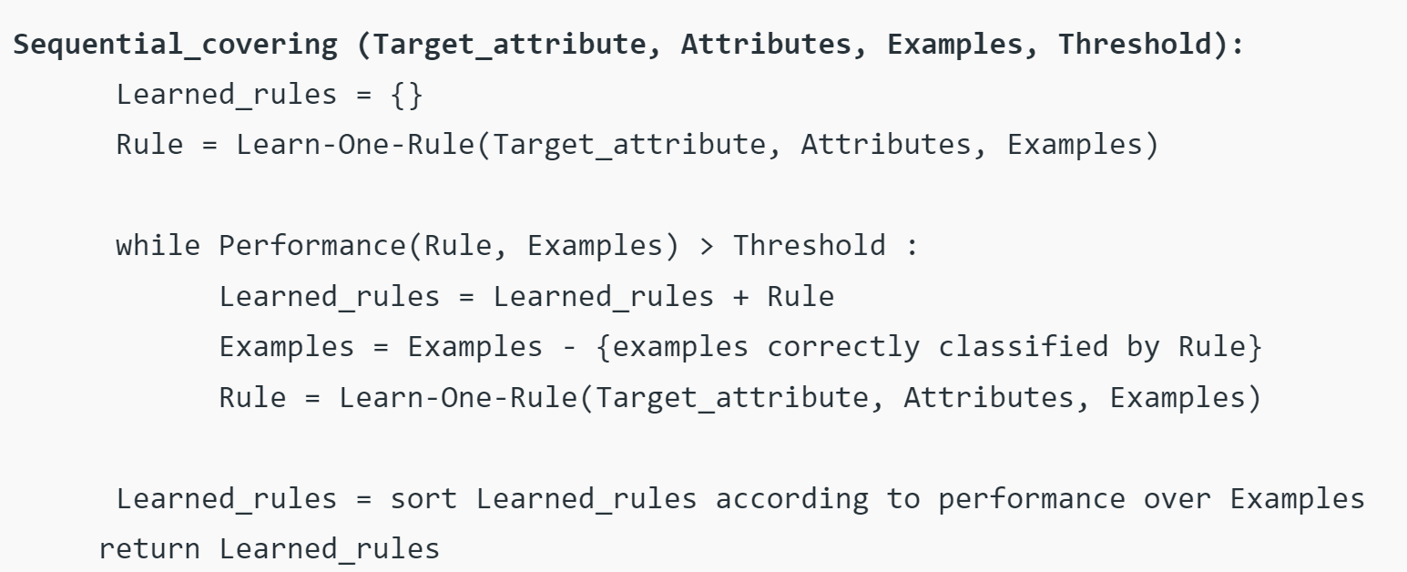
Sequential Covering Algorithm

Slide 13
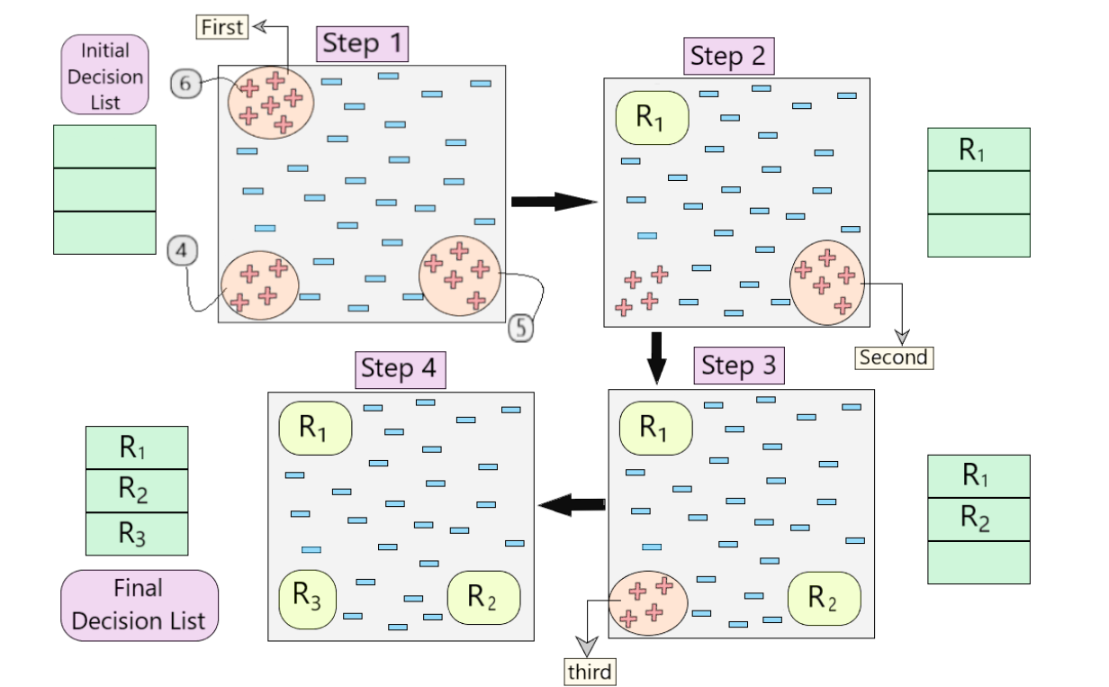
Sequential Covering Algorithm
Below, is a visual representation describing the working of the algorithm.

Slide 14
FOIL’s Information Gain
The measure, similar to information gain, used by FOIL is
Gain(R) = p₁ * ( log₂(p₁/(p₁+n₁)) - log₂(p₀/(p₀+n₀)) ).
p₀ is the number of positive examples in the trainset (initial Rule)
n₀ is the number of negative examples in the trainset (initial Rule)
p₁ is the number of positive examples, covered by R
n₁ is the number of negative examples covered by R

Slide 15
Example
Consider a training set that contains 100 positive examples and 400 negative examples
The rule R1 covers p1 = 30 positive examples and n1 = 10 negative examples. Therefore, the information gain for this rule is
Gain(R1) = 30 [ log(30/40) –log(100/500)] = 57.2

Slide 16
RIPPER
Now that we know all prerequisites, let’s dive into it
Case I: Training records belong to only two classes
Among the records given, it identifies the majority class ( which has appeared the most ) and takes this class as the default class. For example: if there are 100 records and 80 belong to Class A and 20 to Class B. then Class A will be default class.
For the other class, it tries to learn/derive various rules to detect that class.

Slide 17
RIPPER
Case II: Training records have more than two classes (Multiple Classes)
Consider all the classes that are available and then arrange them on the basis of their frequency in a particular order (say increasing)
Consider the classes are arranged as → C1, C2, C3, .., Cn.
C1 : least frequent
Cn : most frequent
The class with the maximum frequency (Cn) is taken as the default class.

Slide 18
RIPPER
How the rule is Derived:
In the first instance, it tries to derive rules for those records which belong to class C1. Records belonging to C1 will be considered as positive examples and other classes will be considered as negative examples.
Sequential Covering Algorithm is used to generate the rules that discriminate between positive and negative examples.
Next, at this junction Ripper tries to derive rules for C2 distinguishing it from the other classes.
This process is repeated until stopping criteria is met, which is negative when we are left with Cn (default class).

Slide 19
RIPPER
Rule Growing in RIPPER Algorithm:
Ripper makes use of general to a specific strategy of growing rules. It starts from an empty rule and goes on adding the best conjunct to the rule antecedent.
For evaluation of conjuncts the metric is chosen is FOIL’s Information Gain. Using this the best conjunct is chosen.
Stopping Criteria for adding the conjuncts – when the rule starts covering the negative examples.
The new rule is pruned based on its performance on the validation set.

Slide 20
RIPPER
Rule Pruning Using RIPPER:
We need to identify whether a particular rule should be pruned or not. To determine this a metric is used, which is
(P – N) / (P + N)
P = number of positive examples in the validation set covered by the rule
N = number of negative examples in the validation set covered by the rule
Whenever a conjunct is added or removed we calculate the value of the above metric for the original rule (before adding/removing) and the new rule (after adding/removing).
If the value of the new rule is better than the original rule then we can add/remove the conjunct. Otherwise, the conjunct will not be added/removed.

Slide 21
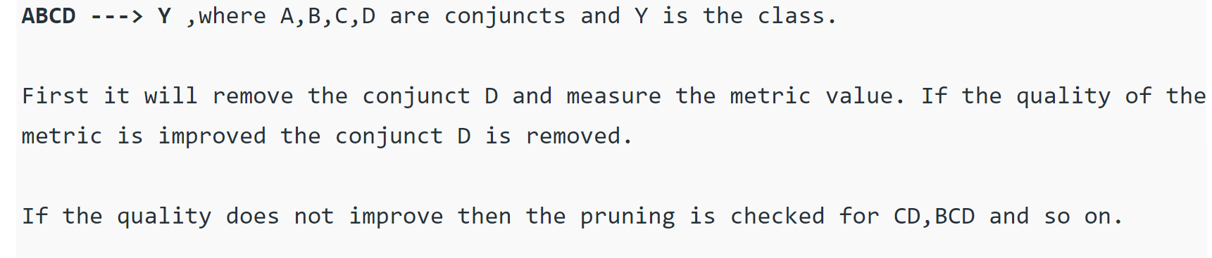
RIPPER
Rule Pruning Using RIPPER:
Pruning is done starting from the rightmost end. For example: Consider a rule -

Slide 22
RIPPER
Building the Ruleset in RIPPER Algorithm:
After a rule is derived, all the positive and negative examples covered by the rule are eliminated.
The rule is then added into the ruleset until it doesn’t violate the stopping condition. The stopping criteria which we can use are
A) Minimum description length principle: For transferring the information from one end to another end you require a minimum number of bits. We want the rule to be represented using a minimum number of bits. If the new rule increases the total description length of the ruleset by d bits ( by default d is 64 bits), then RIPPER stops adding rules into the ruleset.
B) Error Rate – We will consider the rule and calculate its error rate (misclassification) w.r.t the validation set. The error rate of a particular rule should not exceed more than 50%.

